Slide 1


Introduction to HTML & CSS
Instructor: Beck Johnson
Week 3

Slide 2

SESSION OVERVIEW
Review background image and external CSS files
The CSS box model - borders
Block vs inline vs flex elements
Classes and IDs
Coding from a design “comp”

Slide 3

REVIEW!

Slide 4
REVIEW: Linking to external stylesheet
<link href="css/styles.css" rel="stylesheet">
Tells the browser to find and load the styles.css file from the css directory
The rel attribute stands for "relation" - in this case, this link's relationship to the document is "stylesheet"
This tag goes inside the <head> element
Should be on every page that needs the styles

Slide 5
REVIEW: The “CASCADING” Part
The 3 rules for determining how styles get applied:
Styles are applied from far to near
Styles are applied from top to bottom
Styles are applied from parent to child

Slide 6




{} Styles “Location”
REVIEW: near to far
Styles that are “closer” to the elements they style take precedence
Browser default
External styles
(in a .css file)
Internal styles
(in the <head>)
Inline styles
(directly on an element)
Closer to element

Slide 7
REVIEW: Top to bottom
If the same property is styled multiple times for the same selector, the last one sticks.
p { color: #2f4251; }
p { color: #daa645; } /* this wins */

Slide 8
REVIEW: child to parent
If the child is styled differently from the parent, the child’s style is used instead
li { color: #daa645; } /* all list items */
a { color: #e7c0c8; } /* links in general */
li a { color: #c4fe46; } /* links in lists */

Slide 9
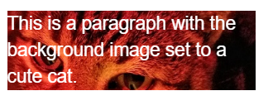
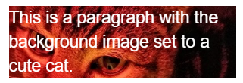
BACKGROUND IMAGES
{ } REVIEW: background images
The background of an element can be an image (instead of a color) using the property background-image
The value is url("path"), where path is the relative or absolute path to where the image lives
p {
background-image: url("images/kitten.jpg");
color: white;
}

Slide 10
BACKGROUND IMAGES
{ } REVIEW: background images
background-position: allows you to move a background image around within its container
background-attachment: images usually scroll with the main view, but setting to fixed means the image stays in place when the user scrolls the page
background-repeat: defines if (and how) the background image will repeat
background-size: specifies how much of the container that the image covers

Slide 11


BACKGROUND IMAGES
{ } REVIEW: background images
background-image can also be a linear-gradient
section { background: linear-gradient(black, white); }
By default linear-gradient draws from top to bottom, but you can set the gradient to draw at an angle instead by starting with to
section {
background: linear-gradient(to right, red, #f06d06, yellow, green);
}

Slide 12
Height and width
{ } REVIEW: height and width
height and width can be set on (most) elements to change how much room they take up on the page
The value must be a positive number
Units are either px or em or %
header { height: 6em; }
min-height and min-width specify minimum dimensions
max-height and max-width specify maximum dimensions

Slide 13
QUESTIONS?

Slide 14
THE CSS BOX MODEL

Slide 15
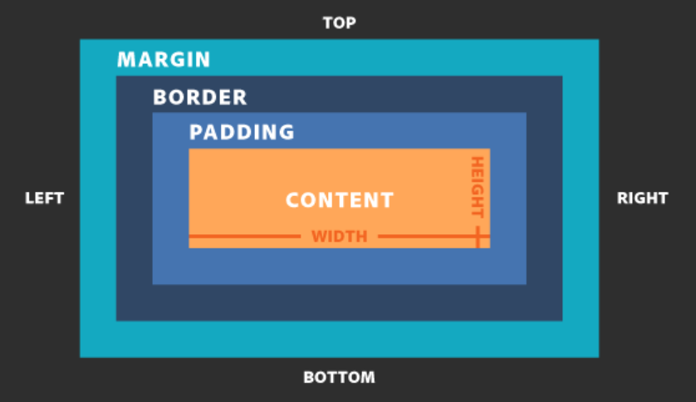
CSS BOX MODEL

Slide 16
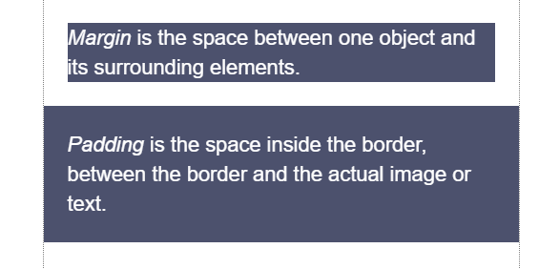
MARGIN vs. padding
Use margin to separate the element from the things that are around it.
Use padding to move the element away from the edges of the block.

Slide 17
BORDER STYLES
Between margin and padding, you can set a border
Values are separated with spaces, in this order:
Width (usually in pixels, but can be em)
Border style (solid, dotted, dashed, etc.)
Color
p {
border: 2px dotted #ff0000;
}

Slide 18
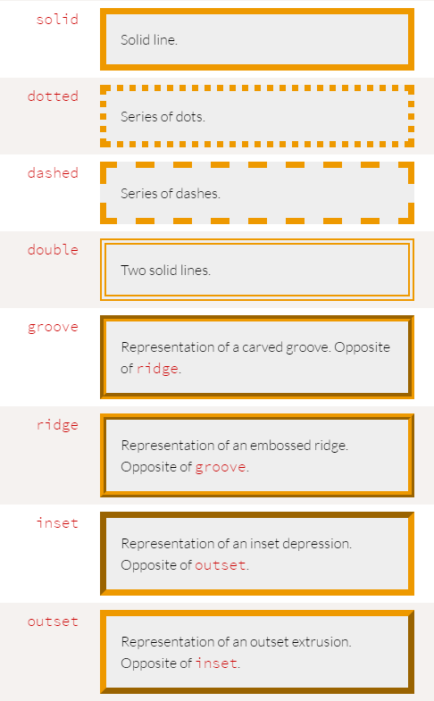
BORDER STYLES
Border styles:

Slide 19

BORDER STYLES
You can set a border on only one side of an element:
h1 { border-bottom: 3px solid black; }

Slide 20

BORDER STYLES
A common use of border is to visually separate list items in a navigation menu.
ul {
list-style : none;
}
li {
padding: 1em;
background-color: #283c51;
border-top: 1px solid #395673;
color: #adadad;
}
<ul>
<li>About us</li>
<li>Products</li>
<li>Services</li>
<li>Contact Us</li>
</ul>

Slide 21
List style
Note that we set
ul {
list-style: none;
}
to remove the bullets that appear
by default on an unordered list

Slide 22
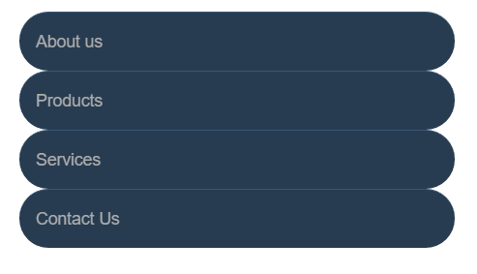
BORDER radius
To make an element appear curved, use the property border-radius
The value is a number (in px or em) or percentage
You can use border-radius even if you don’t explicitly set a border
li {
/* same styles... */
border-radius: 2em;
}

Slide 23

BORDER radius
border-radius can be used to create a circle.
Set border-radius to 50%
Set height and width to the same value
li {
border-radius: 50%;
background-color: black;
color: white;
text-align: center;
height: 3em;
width: 3em;
line-height: 3em;
margin: 5px;
}

Slide 24

BORDER radius
This technique can be used on images to crop them into a circle
Note: if the image itself doesn’t have a square ratio, it will look distorted
<img src="kitten.jpg" alt="Circle kitty" />
img {
border-radius: 50%;
height: 200px;
width: 200px;
}

Slide 25
{ } states in CSS
states in CSS
CSS allows you to apply styles based on the state of an element, for example:
Being hovered over with a mouse
Gaining focus via tabbing or clicking
This is known as a CSS pseudo-class
It’s “pseudo” because the element doesn’t exist in markup – what it selects may change based on user interaction or position relative to other elements

Slide 26

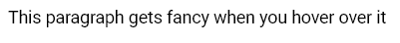
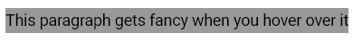
{ } Pseudo ex-psample
pseudo ex-psample
Whenever you see a : in a selector, that style will only apply to elements that are in that state or that position
We saw this already for hovering:
p:hover {
background-color: #999;
}

Slide 27
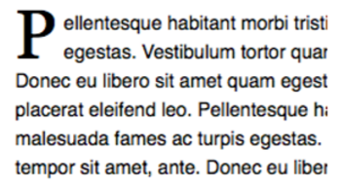
More Pseudo selectors
:first-letter is a way to style the first letter of an element without needing to add markup
p:first-letter {
font-size: 20px;
float: left;
}

Slide 28
More Pseudo selectors
:first-child selects only the first child
:last-child selects only the last child
From the previous example, you would probably only want the first letter of the first paragraph to be big
p:first-child:first-letter {
font-size: 20px;
float: left;
}

Slide 29
More Pseudo selectors
:first-child is also commonly used in lists to style the first element differently from the others
For example, separate list items with borders, but don’t show a top border on the first item:
li {
border-top: 1px solid #333;
}
li:first-child {
border-top: none;
}

Slide 30

PRACTICE TIME!

Slide 31
ASSIGNMENT
Add a list of links in your navigation menu if you don’t already have one
Make the navigation menu pretty by using padding, margin, border, border-radius, background color, and other tricks we’ve learned.
ONLY style lists that are in the nav menu – not any lists that may appear on the rest of the page
Try using a pseudo-selector somewhere on your page to identify an element either by state (:focus, :hover) or by position (:first-child, :first-letter)

Slide 32
<>
Block vs. Inline Elements

Slide 33
<> Block ELEMENTS
<> Block ELEMENTS
Block elements
Expand naturally to fill their parent container
Takes up a “full line”
Can have margin and/or padding
Can have height and/or width
By default, will be placed below previous elements in the markup

Slide 34
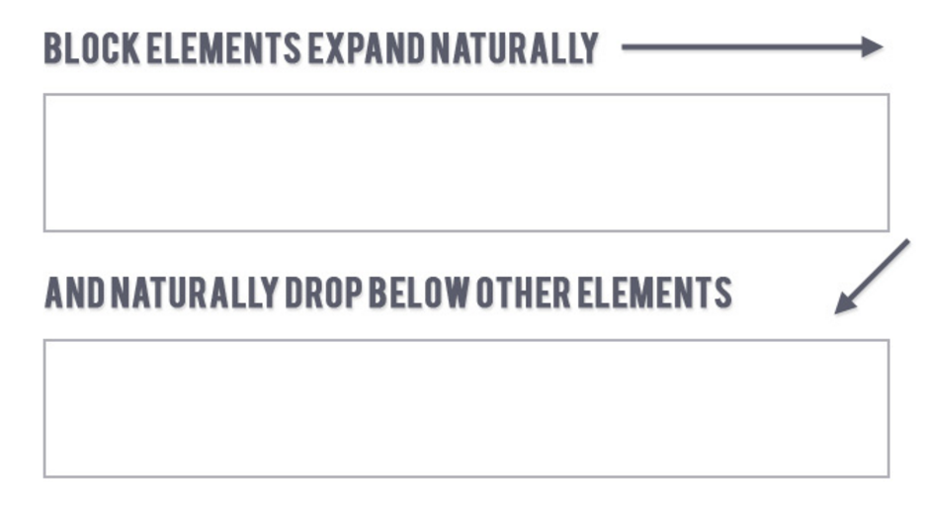
<> Block ELEMENTS
<> Block ELEMENTS

Slide 35
<> Block ELEMENTS
Examples of block elements:
Headings <h1>…<h6>
Paragraphs <p>
Lists <ul>, <ol>

Slide 36
<> INLINE ELEMENTS
inline elements
Flow along with text content
Only take up as much space as necessary
Ignore width and height properties
Margin and padding only pushes other elements away horizontally, not vertically
Top and bottom margin/padding is ignored

Slide 37
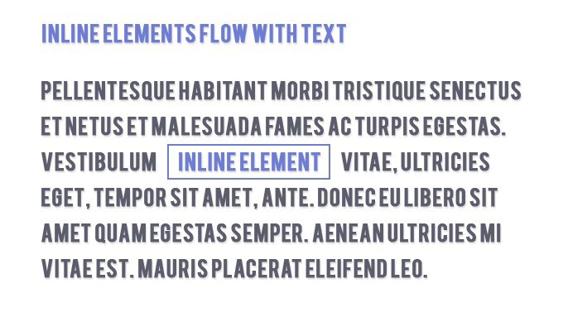
<> INLINE ELEMENTS

Slide 38
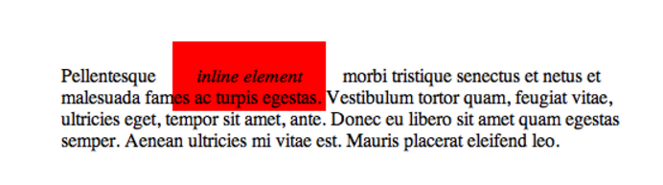
<> INLINE ELEMENTS
Examples of inline elements:
Links <a>
Font emphasis <em>
Font bold <strong>

Slide 39
<> Inline-block elements
inline-block element
Is a hybrid of inline and block
Takes up width and height like block-level elements
Flows with content
Can have margin and padding
Examples of inline-block elements:
Image <img />

Slide 40
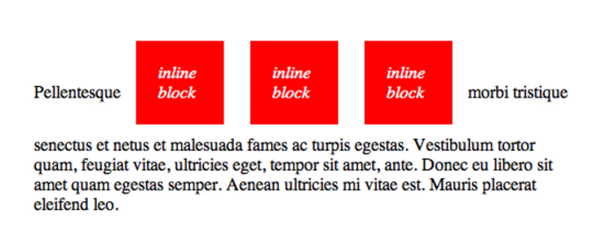
<> Inline-block elements

Slide 41

<> Display
You can change whether or not any element is block, inline, or inline-block by using the CSS display property.
This means we can do some neat things!
li {
display: inline-block;
}

Slide 42
<> flex
Flex
Invented in 2017, this display type allows for better layout control
There are no innate HTML elements that have display: flex
Unlike block, inline, or inline-block, it doesn’t affect itself, it affects the layout of its children

Slide 43
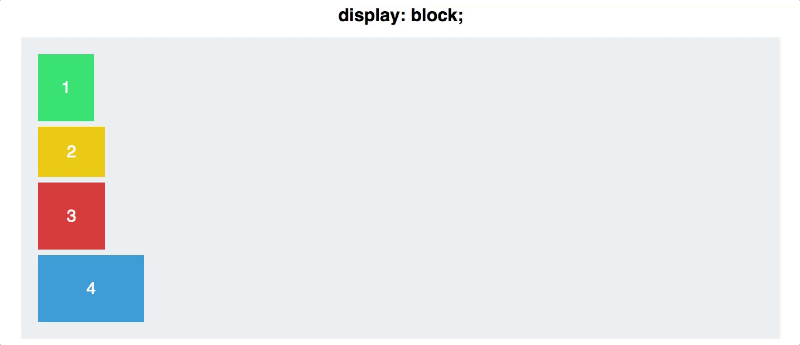
<> flex
By default, display: flex will try to place all its children on the same row
That may mean that they shrink to fit!

Slide 44
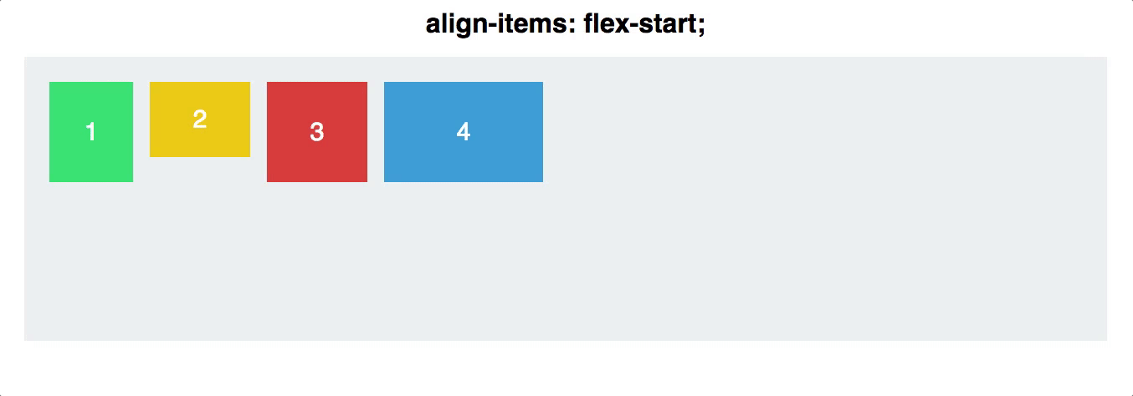
<> flex
We’ll talk more about display: flex next week when we go over layout

Slide 45
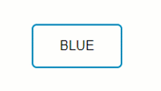
Putting it together
a {
color: #0099CC;
display: inline-block;
border: 2px solid #0099CC;
border-radius: 6px;
padding: 16px 32px;
text-decoration: none;
text-transform: uppercase;
transition: all .4s;
}
a:hover, a:focus {
color: #fff;
background-color: #008CBA;
}
<a href="index.html">
Blue
</a>

Slide 46
PRACTICE TIME!

Slide 47
ASSIGNMENT
Turn your navigation into a horizontal menu using CSS
Give the li elements a display property of either inline or inline-block (or you can try giving ul a display property of flex)
Update your styles so that they look nice in the new orientation
Note: if you like your menu how it is, experiment with changing display of another element on the page instead
Create an <a> link that looks like a button.
Style the button differently on hover and focus and/or click

Slide 48
<html>
(MORE) HTML ELEMENTS

Slide 49
<SPAN> elements
<span></span>
A <span> is a generic inline element
No default style
Used to style inline content

Slide 50
<div> elements
<div></div>
A <div> is a generic block element
No default style
Heavily used as a wrapper for other elements, to create complex layouts

Slide 51
Why use div or span?
Both div and span really need something extra to be useful, since they have no presentation style by default.
Used mostly to create layout
Have no semantic meaning
You don’t need to “reset” them before making them fit your design (like ul or p)
What do they need?

Slide 52
ID & Class selectors

Slide 53
CLASSES AND IDs
CSS lets us target all paragraphs like this:
p {
font-size: 20px;
}
But what if we want to style only some paragraphs?

Slide 54
CLASSES AND IDs
You can add class and id attributes to any HTML element to identify it for styling.
You decide the class and id names – be descriptive!
<p class="important">Big text</p>
<p class="anyLettersOrNumb3rsOr_Or-">Still totally valid</p>

Slide 55
CLASSES AND IDs
Adding a class or id does nothing to an element by default.
Classes and ids don’t have any styling information by themselves
They require you to add CSS if you want styling to be applied

Slide 56
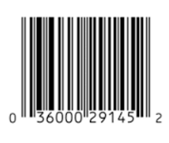

CLASSES AND IDs
Multiple elements can have the same class
A class is like a barcode – all of the same products have the same barcode
Only one element per page can use the same id
An id is like a serial number – it uniquely identifies one specific instance of a product

Slide 57
Class selectors in css
In CSS, target a class with a period
Will style all types of elements that have
that class:
.ghost { color: white; opacity: .1; }
<p class="ghost">Spooooky!</p>
<div class="ghost">This will be spooky toooo</div>

Slide 58
ID Attributes
An id can only be used once per page
Elements cannot have multiple id attributes
<div id="mainContent">
<!-- This better be the only one! -->
</div>

Slide 59
ID selectors in css
<div id="lego"></div>
In CSS, target an id with a hash:
#lego {
display: block;
}

Slide 60
IDs for anchoring
If you put a hash followed by the element’s id in the URL, the browser will jump to that location on the same page:
<a href="#kittens">Proceed directly to kittens</a>
...
<div id="kittens">Meow<div>

Slide 61
ID Attributes
Q: What horrible thing will happen if you use an id twice on the same page?
A: Well…actually nothing.
But your page won’t validate
Jump links will go to whatever id appears first
And any JavaScript that needs to locate that specific element will fail

Slide 62
how to choose - class or id?
If you think it’s likely or possible that you’ll want to apply the same style to multiple things, definitely use class
If your element is guaranteed to be the only one on the page, you can use id – or you can still use class
If your element needs to be linked to directly, use id

Slide 63
PRACTICE TIME!

Slide 64
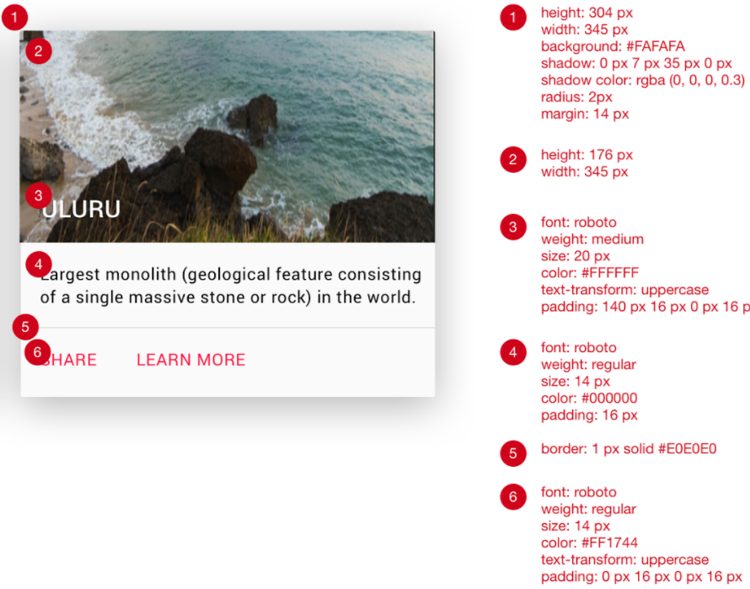
{ } match the comp
Using all the techniques you’ve learned, try to match this comp:

Slide 65
{ } match the comp: Tips
Create a new page. You can put CSS in the <head> or create a new stylesheet, your choice
For the tiles: <div class="tile"></div>
Use this URL to generate a random nature photo for your background image:
https://placeimg.com/344/204/nature
Use a <nav> for the row that contains links
Either add a class to this <nav> or identify it using .tile nav in your CSS
To get the drop-shadow effect, apply this CSS to .tile
box-shadow: 0 7px 35px 0 rgba(0, 0, 0, 0.3);

Slide 66
HOMEWORK
On index.html or aboutme.html, give an element a descriptive class and apply a special style to it using a CSS class selector
Style a child element of this element
Assign an id to an element on your page and apply a unique style using that id selector
Optional: create a link that jumps to that element
Email me your files at beckjohnson@gmail.com

Slide 67

“HOMEWORK”
Practice!
Optional: read chapter 8 of HTML and CSS: Design and Build Websites
Try playing with this interactive demo of the CSS box model

